Slide 1

Malignant Comments Classifier
Konatala Mohit
Intership-23 , ID-34

Slide 2

Abstract
Introduction
Descriptive Analysis
Data cleaning and modifying
Data Visualization
Feature Selection and Model Training
Conclusion

Slide 3

Abstract
Data analysis and model building on provided data from flip robo technologies to predict the classification of the i.e., if the comment is malignant or not.

Slide 4

In this presentation I will be discussing about text classification of malignant comments by using nltk library and few of the machine learning models via python and its libraries. Social media platform is one most online surfed platform in today’s world. Social media allows any individual to explore all the happening around the world via test data and visual clipping. It allows us to explore the content that we desire for and enlighten us with knowledge that is there to be grabbed. How much so ever the social media is a boon to us though it is equally bane to us as it leads to whole lot of vitriol and toxic data and comments. Malignant comments are the comments which consists of abusive words, aggressive phrase or the comments which are tend to be cyberbullying and such set of comments are recognized as harmful threat to the social media.

Slide 5

Exploratory Data Analysis
Objective:
Analysis of the data set and summarizing the factor that effect the classification of the label.
Understanding the Data Via Descriptive analysis
Size of the train data is large contains only 159571 and 7 rows in train and test respectively. Test data is 153164 and 2 rows
Label is the target column

Slide 6
Data contains does not contain any Null Values
Data contains text in string format
Descriptive analysis is used as it gives the basic value Insite of the data in our dataset.
It helps in organize the data and summarize the data while describing the characteristic of data.

Slide 7
Data Visualization
Data visualization is one simplest way to get a proper idea about the characteristics of the data just from vision. In much simpler words , we Visualize the descriptive stats of the data in pictorial format. Also the data characteristic are represented in eye soothing way
Identifying pattern, understanding is the data is more easier through visuals.

Slide 8
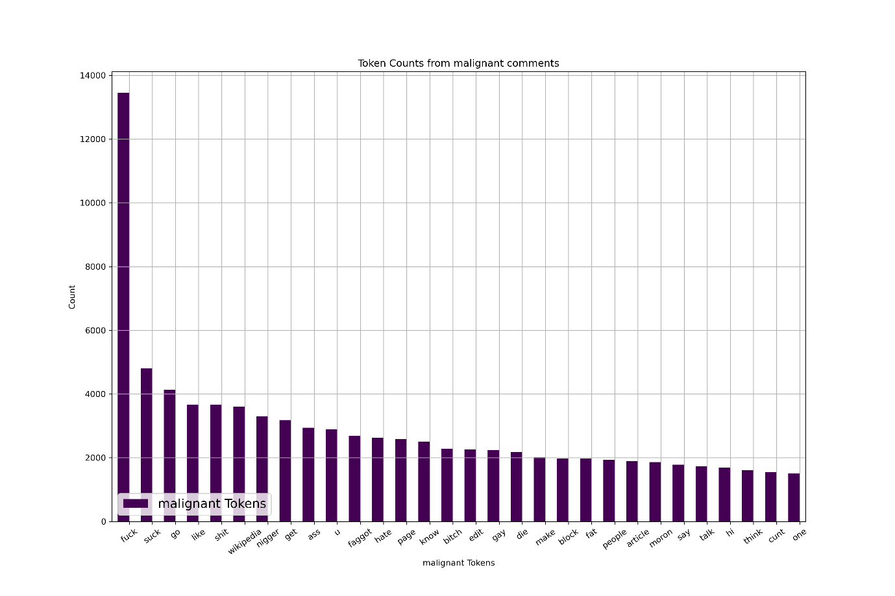
Independent variables influencing the target variable pie chart

Slide 9
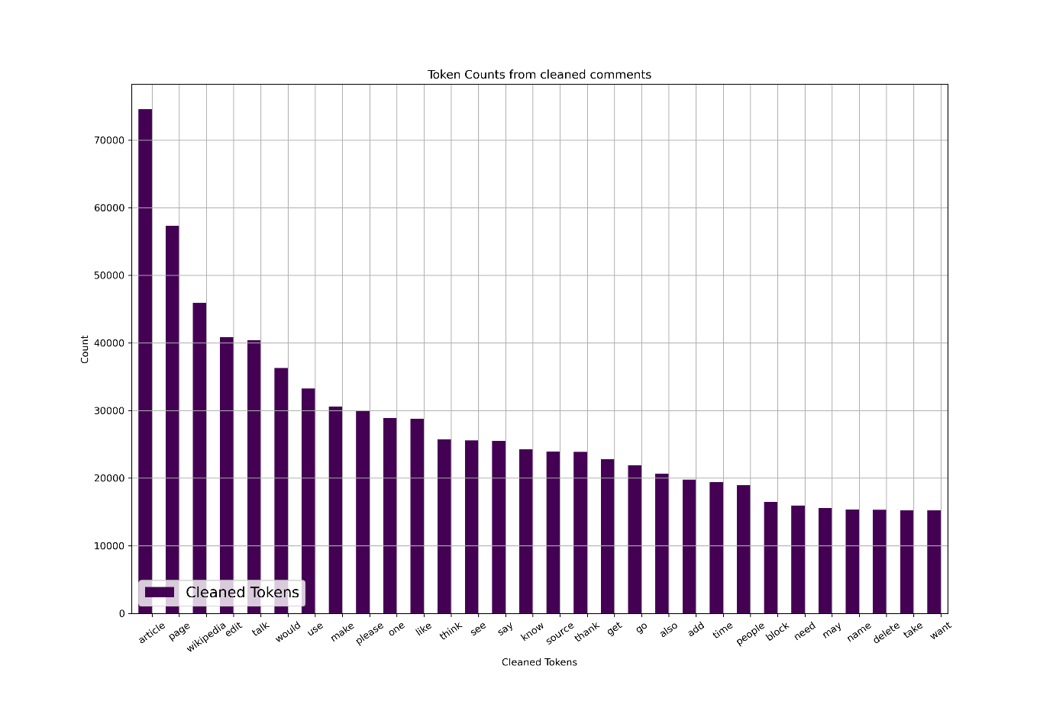
Independent variables influencing the target variable pie chart

Slide 10
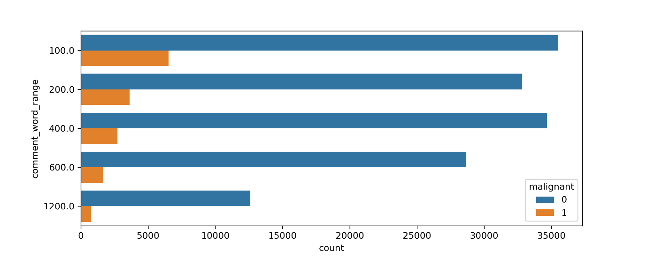
Bivariate Analysis

Slide 11
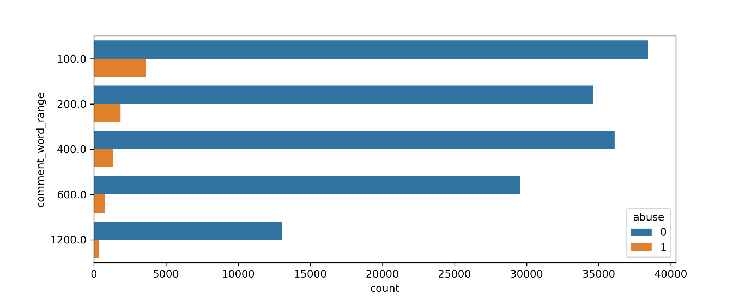
Bivariate Analysis

Slide 12

Bivariate Analysis

Slide 13
Cleaning the Data
Cleaning data is one of the most important procedure in data analysis i.e. detecting and modifying or removing the inaccurate data from the dataset so as improve data quality
Tasks in data cleaning:
Word Tokenization
Removal of Punctuation and stop words
Lemmatization of the words
Feature Selection

Slide 14
Data Transforming:
label token frequency inverse document frequency vectorizer to transform and fit the ordinal data present in the data set into numerical form. Tfidfvectorizer not convert the data into numerical form but has the ability to normalize the data.
Pipeline of model and prediction:
After separating the train and test data we use Pipeline for model training and prediction as it makes the process simpler.

Slide 15

Below the keys point in Summarizing the data analysis of Micro Credit Prediction data:
Size of the Dataset is 159571 rows .
No missing values in the dataset.
Converted text data into numerical data.
Separate features and prediction variables into two separate list.

Slide 16
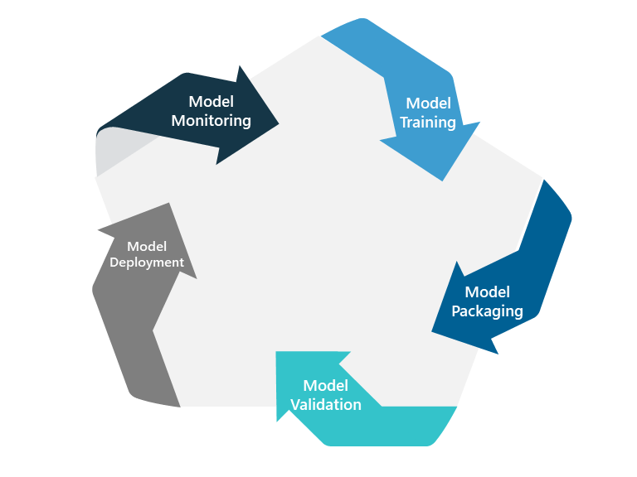
Model Training and Testing
Splitting the Data into Train and Test sets
Pipelining the model
Using hyperparameter tuning to get the best estimator for the model
Model Training
Cross Validation
Model Testing
Saving the model

Slide 17
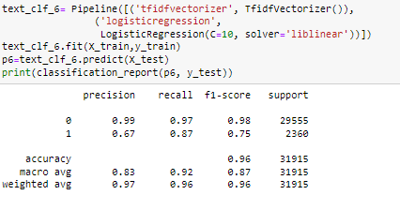

Slide 18
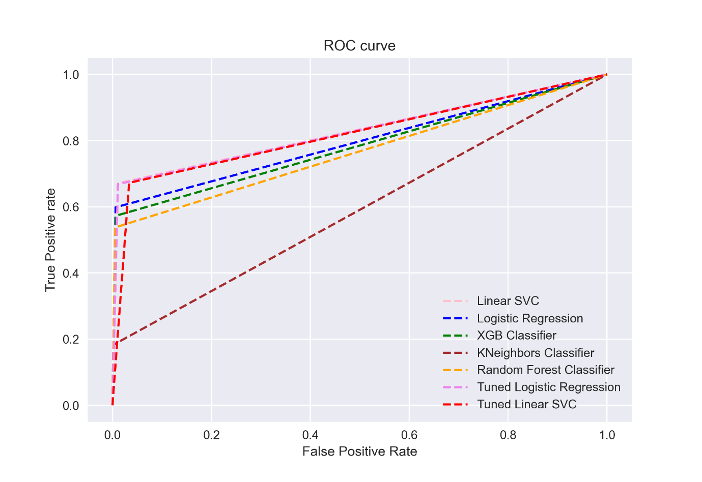

Slide 19

Limitations of this work and Scope for Future Work:
The label predicted are only limited to particular malignant comment. When we try to predict for label the machine learning model will fail. To improve the model efficiency, we can add more of failure label in order to balance the data and get much improved precision, recall and f1-score for the given model. Also by removing more unnecessary words from the data which are not affecting the output data the model can be improvised.
Conclusion:
In the whole dataset the top 15 words which were visualized must have the most influence on the label columns.

